Slide 1
OBJECT DETECTION USING CNN
PRESENTED BY:
S. JANANI
513121104011
THANTHAI PERIYAR GOVT INSTITUTE OF TECHNOLOGY,VELLORE
3/21/2024 Annual Review

Slide 2
PROJECT TITLE
OBJECT DETECTION USING CNN
3/21/2024 Annual Review

Slide 3


AGENDA
Problem Statement
Project Overview
End Users
Our Solution and Proposition
The wow in your solution
Modeling
Results and Evaluation
Conclusion
3/21/2024 Annual Review

Slide 4

PROBLEM STATEMENT
Develop a Convolutional Neural Network (CNN) based model for object detection in images. The model should be able to identify and locate objects within images, marking their positions with bounding boxes. The project aims to create an efficient and accurate object detection system that can be applied to various domains, such as surveillance, autonomous vehicles, and industrial automation, among others
3/21/2024 Annual Review

Slide 5

PROJECT OVERVIEW
This project aims to develop an object detection system using Convolutional Neural Networks (CNNs) to accurately identify and localize objects within images. It involves dataset collection and annotation, designing a CNN architecture for object detection, training the model, and optimizing it for real-time inference. Evaluation metrics will validate its performance, and documentation will detail the process for future reference and improvements.
3/21/2024 Annual Review

Slide 6

WHO ARE THE END USERS?
Researchers and Academics
Software Developers and Engineers
Data Scientists and Machine Learning Practitioners
Industry Professionals
Students and Educators
Entrepreneurs and Innovators
3/21/2024 Annual Review

Slide 7

YOUR SOLUTION AND ITS VALUE PROPOSITION
High Accuracy: Our CNN-based model is meticulously trained on diverse datasets to ensure high accuracy in detecting objects across various classes, sizes, and orientations. This reliability enables precise decision-making in critical applications such as autonomous vehicles and surveillance systems.
Real-Time Performance: Optimized for efficiency, our solution delivers real-time object detection, allowing for timely responses in dynamic environments. This capability is crucial for applications requiring rapid processing, such as surveillance monitoring and industrial automation.
Robustness and Adaptability: Our system exhibits robustness to occlusions, clutter, and variations in lighting conditions, ensuring reliable performance across diverse real-world scenarios. Its adaptability allows for seamless integration into various industries, from retail and healthcare to smart cities and gaming.
3/21/2024 Annual Review

Slide 8

THE WOW IN YOUR SOLUTION
Precision Beyond Expectations
Instantaneous Response Time
Adaptability to Any Challenge
Streamlined Productivity and Safety
Future-Proof Innovation
3/21/2024 Annual Review
8

Slide 9
MODELLING
Data Collection: Gather a dataset of images with annotated bounding boxes for object detection.
Data Preprocessing: Resize the images to a consistent size and format them for input into the CNN model.
Mask Creation: Generate masks for training the model, indicating the presence and location of objects within the images.
Model Design: Design a CNN architecture suitable for object detection, including convolutional, pooling, and fully connected layers.
Model Training: Train the CNN model using the prepared dataset and masks to learn to detect objects in images.
9

Slide 10
6.Model Evaluation: Evaluate the trained model using a separate validation dataset to assess its accuracy and performance.
7.Model Optimization: Fine-tune the model and adjust hyperparameters to improve its performance if necessary.
8.Deployment: Deploy the trained model for object detection tasks, such as detecting objects in real-time images or videos.
9.Testing and Validation: Test the deployed model on new datasets to ensure its effectiveness and validate its performance.
10.Maintenance and Updates: Maintain the model by periodically updating it with new data and retraining it to improve its accuracy and adaptability to new scenarios.

Slide 11
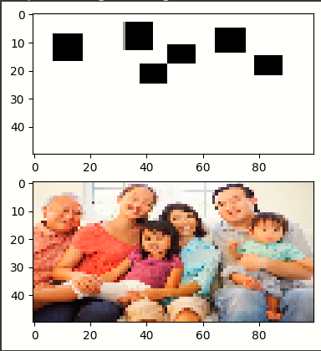
RESULTS
Objects are detected as the black boxes in result graph
Demo Link
3/21/2024 Annual Review
11

Slide 12
CONCLUSION
In conclusion, modeling for object detection using Convolutional Neural Networks (CNNs) is a multi-faceted process that involves meticulous data preparation, careful selection or design of the model architecture, rigorous training and evaluation, fine-tuning for optimal performance, and seamless deployment into real-world applications. By following these steps, developers can create robust and efficient object detection systems capable of accurately identifying and localizing objects within images or video streams. Furthermore, ongoing monitoring and iteration ensure that the model remains effective and adaptable to changing environments and requirements. With the advancements in CNNs and computer vision techniques, object detection continues to evolve, offering exciting opportunities for innovation and practical solutions across various industries and domains.

Slide 13
THANK YOU

